Slide 1
2nd/3rd Australian Light Anti-Aircraft Regiment 2nd Australian Imperial Forces (AIF)
Consisting of
Regimental Headquarters
7th, 8th and 9th Batteries
(of 3 troops each)
2/3 LAA Regiment Signal Section
Light Aid Detachment – Workshop Section

Slide 2
2nd /3rd Australian Light Anti-Aircraft Regiment 2nd Australian Imperial Forces (AIF)
Formed 18th July 1940
Disbanded 12th July 1943
(source: Regimental War Diary)
And the subsequent service of
7th, 8th and 9th Batteries
until the end of World War II

Slide 3
This information has been developed from the photos, diaries, publications and recollections of members of the 2/3 ALAA Regiment to assist younger generations to understand the history of the regiment.
It has been prepared in the spirit of those words from the preface of On Target, the official history of the regiment:
“This book is about young men, some of whom left young families behind when they volunteered to give up their freedom for as long as it would take to restore freedom to those who had been deprived of it.
It is about those young men, with inadequate equipment, given tasks which placed their lives unnecessarily in jeopardy.
The book is not about the glorification of war, but about the comradeship, the team spirit and the initiative of these young men.
It is written in memory of those who gave their lives, or who were maimed physically or mentally, and those who mourned or cared for them. This book remembers too, the wives, the parents, the families and the sweethearts who were concerned for the men they loved.”

Slide 4
This presentation includes images of members of the Regiment and others. Any offence that this may cause to anyone who is depicted, or their relatives or descendants, is unintentional.
We welcome additions, corrections or amendments via 2/3 Remembrance Group Hon. Secretary, at abr18751@bigpond.net.au.

Slide 5
Particular thanks to original members Ron Bryant (8th Battery), John Campbell (8th Battery) and Cec Rae (9th Battery), and to Dot Harris daughter of Les Harris (7th Battery), Lynton Rose son of Clive Rose (RHQ) and David McDonald son of Robert McDonald (Signals) for original material and checking the accuracy of captions and to Colin Bragg son-in-law of Jim Paton (9th Battery) who collected and scanned the images.
Compiled and captioned by Anne Rae, daughter of Cec Rae (9th Battery).

Slide 6
Bofors not to be seen before reaching the Middle East
(Source unknown)

Slide 7
The 2nd/3rd Australian Light Anti-Aircraft Regiment
Successes achieved by Germany early in World War II created an urgent demand for light anti-aircraft artillery to combat the menace.
The 7th, 8th and 9th Batteries of the 2nd/3rd Australian Light Anti-Aircraft Regiment established in 1940 were the first unit in the AIF raised to combat the scourge of the dive-bombers and low-flying strafing aircraft
Adapted from the fly-leaf of On Target 1987

Slide 8
The Regiment, in action, rarely functioned as a unit but rather in Batteries with Troops scattered and individual guns often allocated separate roles, acting independently.
The Regiment’s members participated in operations in the Western Desert, Tobruk, Crete, Syria, Australia, New Guinea, the islands and North West Borneo.
Adapted from the fly-leaf of On Target 1987

Slide 9
Caulfield Racecourse - on parade 1940

Slide 10
Caulfield Racecourse marching competition against infantry recruits Lt. Willis in charge “WE WON”

Slide 11
Caulfield Racecourse - Scotty Gray in the Guineas Stand accommodation. Grandstand beds were cold in August 1940

Slide 12
Caulfield Racecourse – members’ car park Jim Paton, George Prince, Harold Cole

Slide 13
Werribee racecourse camp December 1940

Slide 14
Werribee – on bivouac (possibly Hoppers Crossing)

Slide 15
Cec Rae modelling gas mask at Werribee camp

Slide 16
Werribee racecourse camp

Slide 17
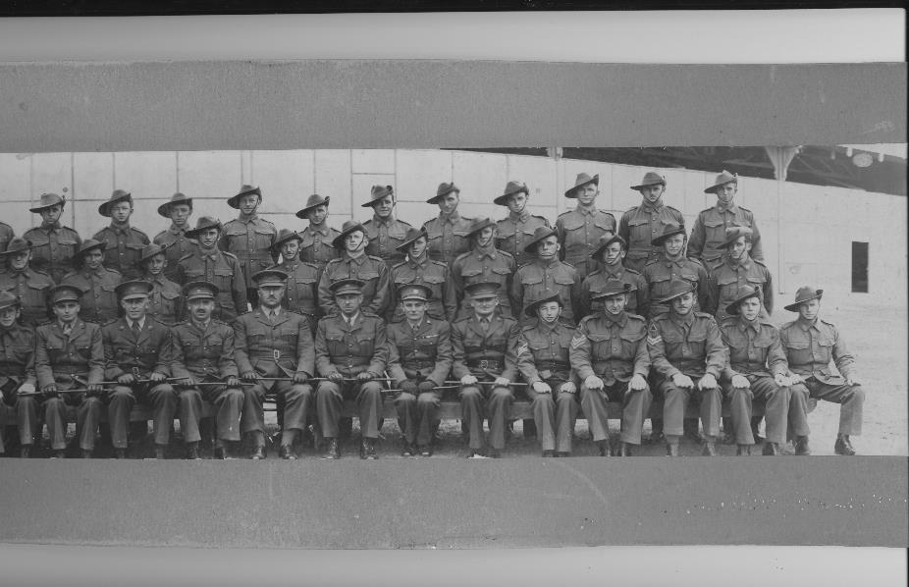
Regimental Head Quarters Werribee 1940

Slide 18
Brigadier Munro – Salvation Army
Brigadier A.S. Munro administered the Salvation Army Red Shield Hut at Werribee.
Due to his age he was unable to travel with the Regiment. Because of his compassion he was a great favourite with the men.

Slide 19
Padre Daws Werribee

Slide 20
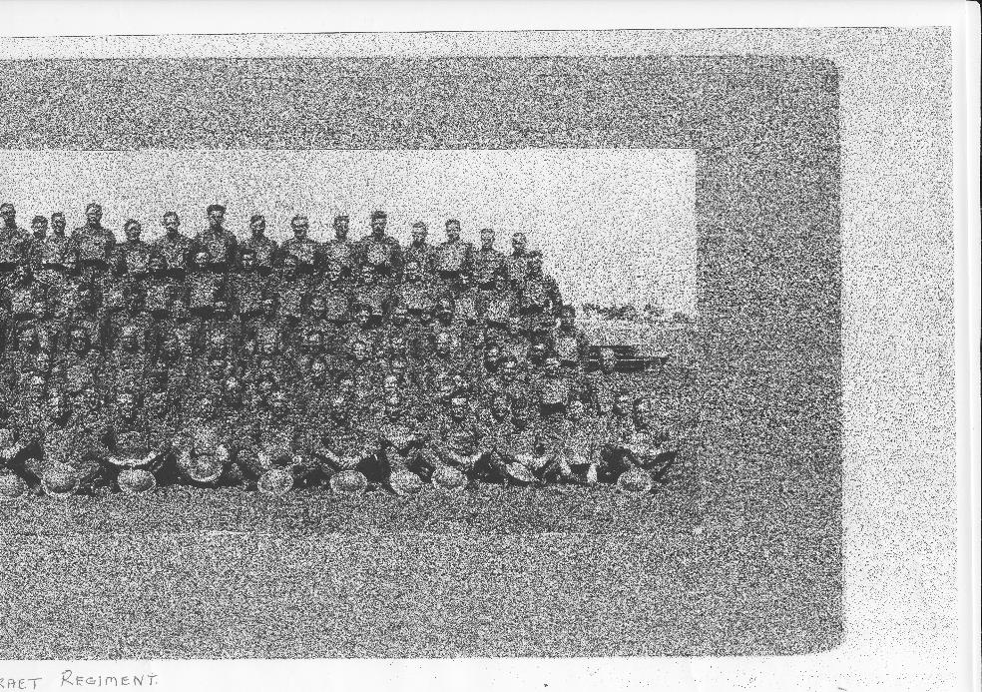
7th Battery Werribee 1940
mber 1940

Slide 21
7th Battery Officers and NCOs

Slide 22
Some of 7th Battery Werribee
ee

Slide 23
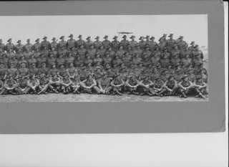
8th Battery Werribee 1940

Slide 24
Some of 8th Battery Werribee 1940

Slide 25
8th Battery Officers Werribee Race Course 1940

Slide 26
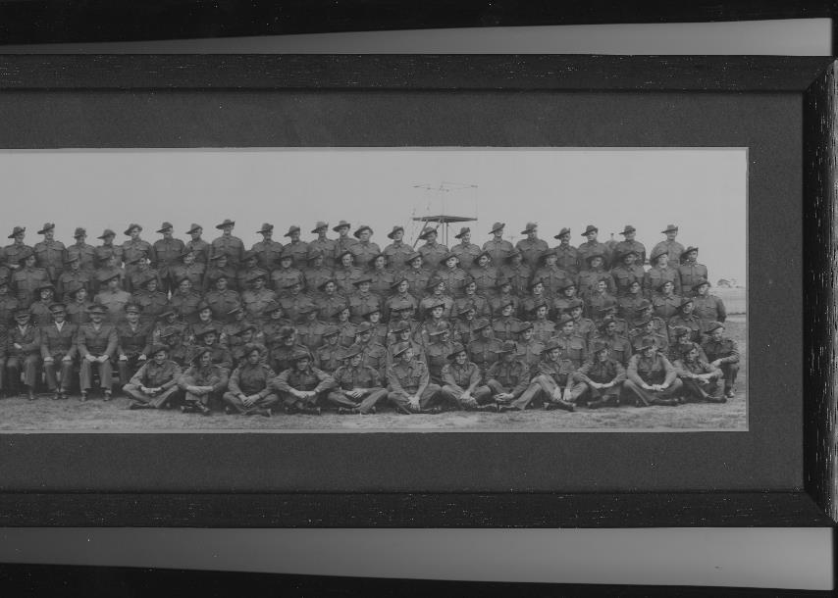
9th Battery - Werribee 1940

Slide 27
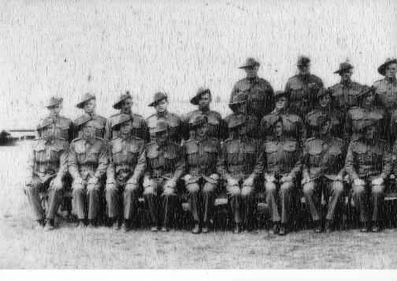
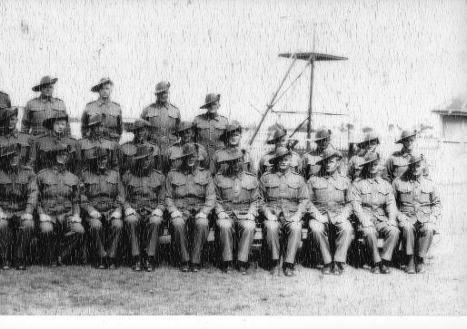
INK Troop 9TH Battery Werribee Racecourse 1940

Slide 28
Some of 9th Battery Werribee Race Course 1940

Slide 29
Prior to embarkation – Melbourne Scott Robson leading

Slide 30
Swanston Street

Slide 31
H.M. Troopship Mauretania
The Regiment departed from Station Pier, Port Melbourne aboard the Mauretania at 1700 on 29th December 1940.
The (second) Mauretania was launched on 28 July 1938, and named in honour of the previous record breaking Mauretania which was retired in 1935.

Slide 33
On board the Mauretania (1)

Slide 34
On board the Mauretania (2)

Slide 35
On board the Mauretania (3)

Slide 36
The Regiment landed in Colombo, Ceylon on 12th January 1941 and were transferred to H.M. Troopship Devonshire for the remainder of the voyage to Palestine.
8th Battery

Slide 37
8th Battery

Slide 38
The Devonshire arrived in Haifa, Palestine on 30th January 1941 and the Regiment disembarked on the following day. From Haifa the Regiment entrained to Khassa camp.
During leave the men were able to visit Jerusalem, the Dead Sea, Tel-Aviv and Rehovot.
The Prime Minister, Mr. Menzies, visited the regiment at Khassa Camp on 4th February.

Slide 39
Palestine showing Haifa and El Majdal near Khassa Camp

Slide 40
On 6th February, 8th Battery moved by train to Alexandria and thence by ship to Tobruk, Libya.
The Regiment (without 8th Battery) then moved to El Amiriya Camp near Alexandria , Egypt.
On 14th April 1941, the regiment received orders for movement to Alexandria to join “Lustre Force” for the defence of Greece, but the orders were cancelled five days later.

Slide 41
7th battery was ordered to Crete to take over the air defence of British Navy Air Bases and to await the arrival of the Royal Marine Base Defence organisation from Great Britain. 7th Battery moved out of El Amiriya Camp on 22nd April 1941.
Regimental Head Quarters and 9th Battery joined the Western Desert Force and left El Amiriya Camp by truck for Abu Haggag on 23rd April 1941.

Slide 42
Arriving in Palestine Rol Tonkin and Max Whiteside

Slide 43
Procuring oranges Jack Curry (left) and mate

Slide 44
On leave John Marshall and mates, waiting for a tram

Slide 45
John Marshall and mates after a hockey match - Palestine

Slide 46
7th Battery
Palestine
Crete-
Heraklion, Maleme, Retimo
Sphakia
Western Australia
New Guinea

Slide 47
Palestine 7th Battery

Slide 48
Palestine – 7th Battery, A Troop

Slide 50
Jack Curry’s gun crew March 1941 Palestine

Slide 51
Dave Humphreys 7th Battery commissioned

Slide 52
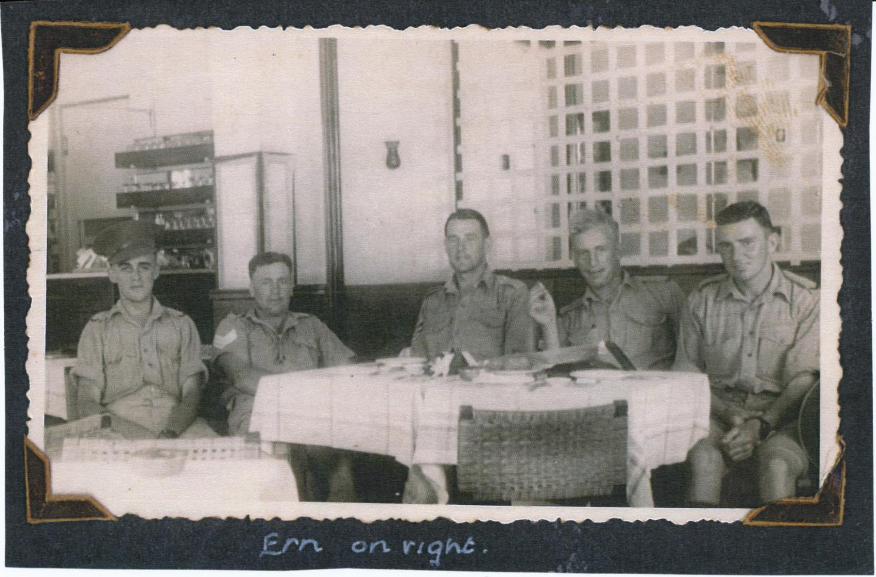
Ern Cope and mates (7 Bty)

Slide 53
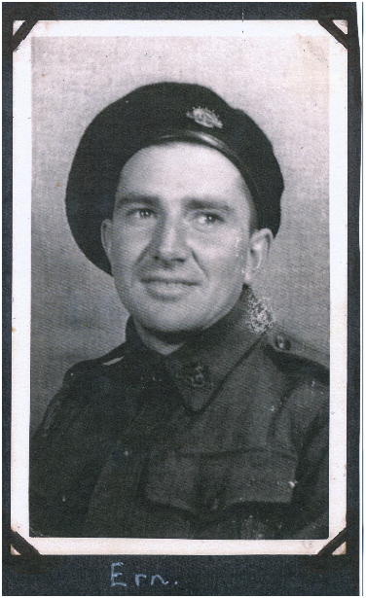
Ern Cope

Slide 54
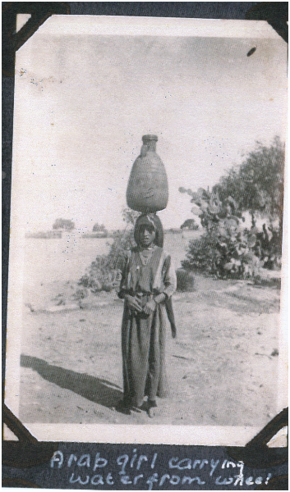

Slide 56
Palestine

Slide 58
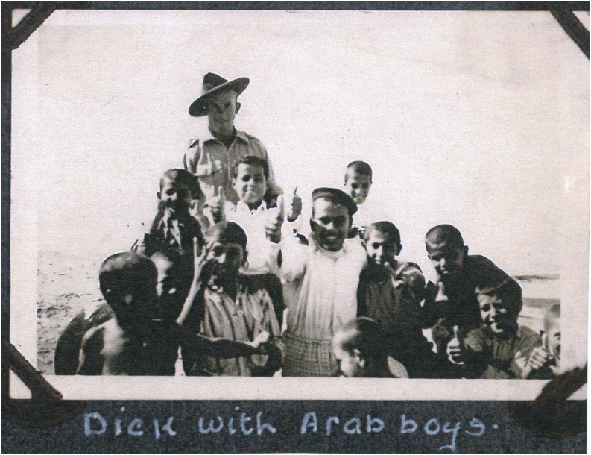
Dick Telford

Slide 59
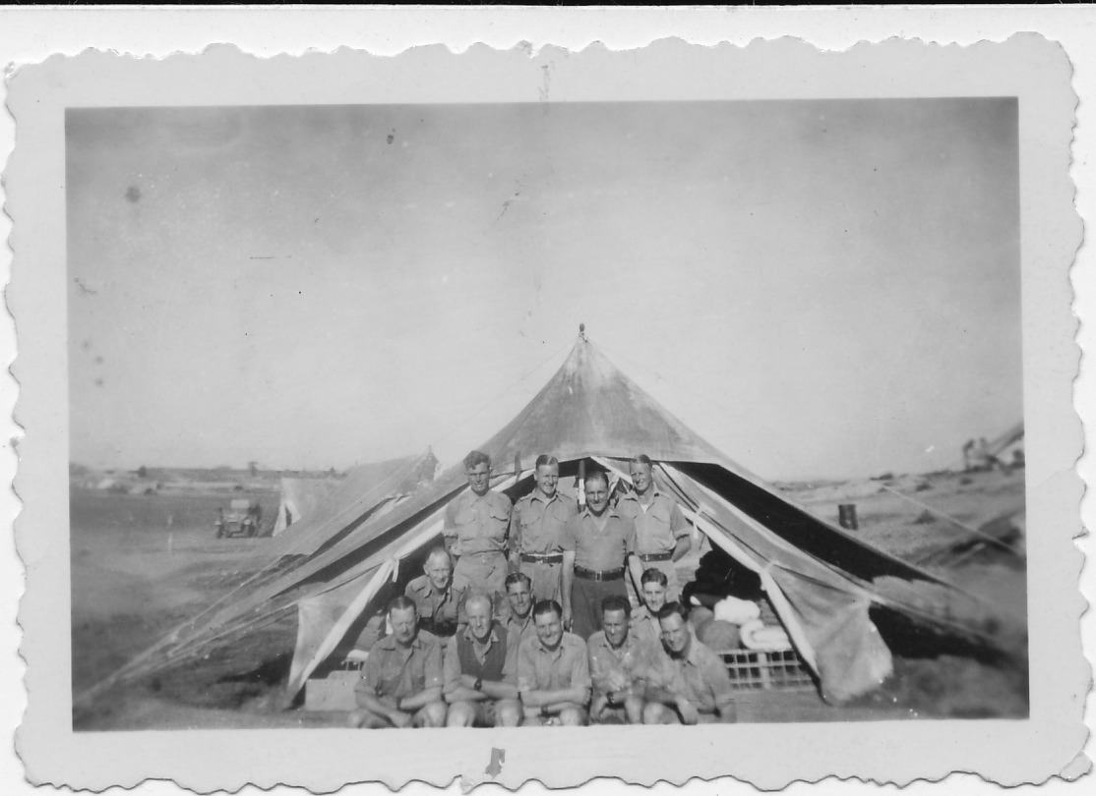
Rol Tonkin (7 Bty) Gun Crew April 1941

Slide 60
7th Battery
Following the ill-fated campaign and defeat of the British Forces in Greece in
April l94l, the evacuation of Greece had already begun when 7th Battery arrived in
Crete on 24th April to occupy static Bofors gun-sites defending Suda Bay, Maleme
and Heraklion airfields.
The well planned German campaign culminated in a massive airborne assault
launched by gliders, parachute and airborne troops between the 20th and 30th
May capturing control of the island.
The Battery's losses were disastrous. Of 250 men, 55 were killed and 107 were
taken prisoner, apart from the loss of their Bofors anti-aircraft guns.
The cost of the enemy's success was high. The Battery was credited with shooting
down 62 enemy aircraft. Despite the audacity and organization of the airborne
invasion and the enemy's mastery in the air, the losses of airborne troops in the
vicious fighting were so great that such a large scale airborne operation was never
undertaken again by the Germans. The graves of 4,465 elite airborne troops in the
Maleme War Cemetery bear mute testimony to the tragic German losses.

Slide 61
The men of 7th Battery who were captured suffered four years as prisoners in Europe often on farms and in labour camps. Despite severe hardships, and some risky escapes, most survived; but many of the men had physical and mental scars. The Mediterranean Fleet suffered heavy losses from aerial bombing during the gallant evacuations of British, Australian and New Zealand troops from Heraklion and Sphakia.
Back in Palestine, reinforced and refitted, some of the troops relieved gun crews of 9th Battery in Syria, while others were transferred to the new 2nd /4th Light Anti-aircraft Regiment.
In February 1942, some of the gunners returned to Australia on the Andes; but others with their guns provided protection for many individual transports carrying equipment and supplies to Australia, the last of them arriving on l3th April, to be re-united with the Battery at Pearce airfield in Western Australia..
Later at Geraldton, the guns were handed over to 152 L.A.A. Battery. Some members joined the 2nd /8th L.A.A. Battery which went to Buna in New Guinea.
Others went to Oro Bay, also in New Guinea.
In October 1944, the Battery returned to Australia for jungle training, but by 3rd September 1945, the 7th Battery was disbanded.

Slide 62
Ken Welsh (right) and mates
Egypt 1941

Slide 63
Les Harris’s pay book -7th Battery

Slide 64
Crete- Maleme aerodrome

Slide 65
Maleme, April 41

Slide 66
Crete – parachute attack

Slide 67
Suda Bay, 20 May 1941

Slide 68
Crete – troops awaiting evacuation, Sphakia beach

Slide 69
Crete – Sphakia beach troop evacuation point from Crete to Egypt

Slide 70
HMS Hereward – evacuated many of B Troop from Heraklion but was sunk by enemy fire.
Many evacuees were drowned.

Slide 71
On board HMS Kelvin – evacuating from Sphakia

Slide 72
Ken Welsh
in German Stalag
August 1942
Ken Welsh in German Stalag
August 1942

Slide 73
Roy East 7th Battery

Slide 74
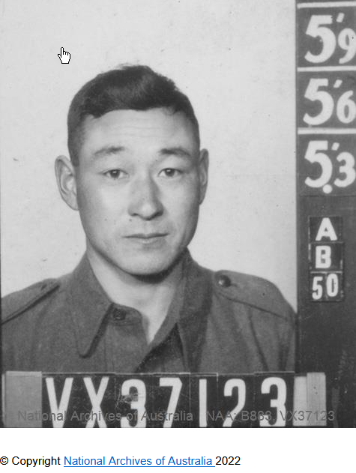
Mario (‘Murray’ or ‘Tak’) Takasuka VX37123

Slide 75
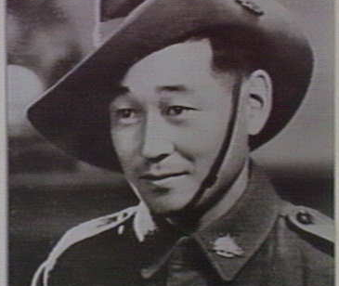
‘Mario on leave in Cairo, 1941’
Source: State Library of Victoria

Slide 76
Hill 95 August 1941

Slide 77
Reinforcements Beirut September 1941

Slide 78
7th Battery – group 2 in Egypt

Slide 79
7th Battery – group 7 in Egypt

Slide 80
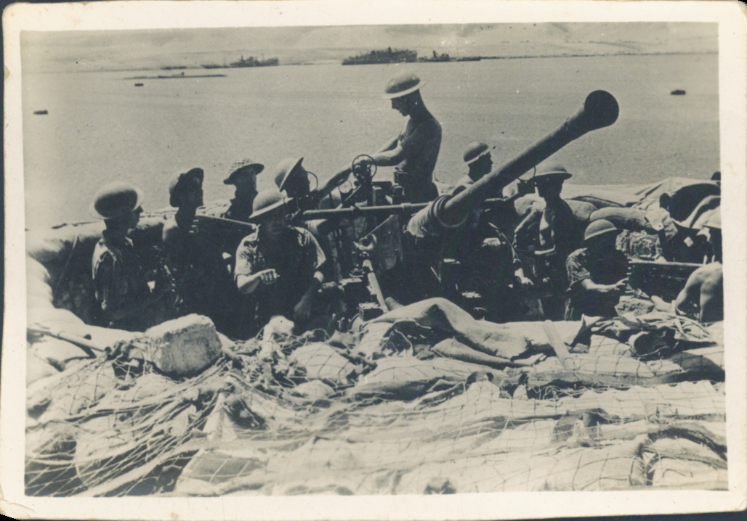
Rex Emmett (& Bty) loading Bofors 1942

Slide 81
Loading at Suez Leaving the Middle East to return home

Slide 82
S.S. City of Hankow with gun, tractor and truck aboard

Slide 83
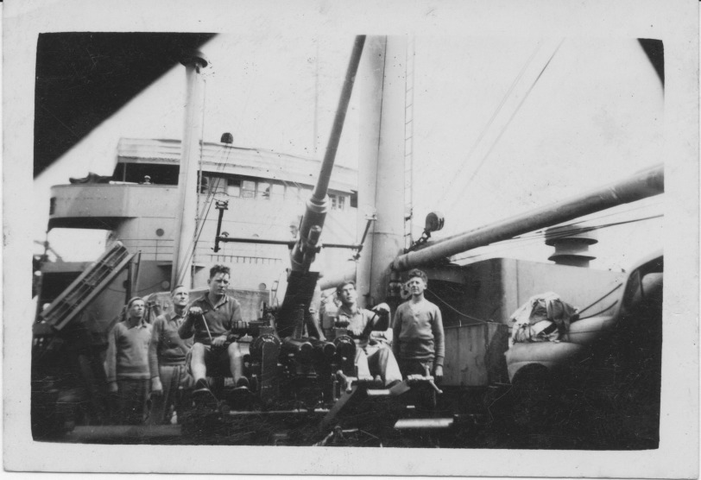
On board Empire Pintail March 1942 Returning from the Middle East

Slide 84
Western Australia – Swan River 7th or 8th Battery
Catalina flying boats, with extra fuel tanks , flew from Perth to Ceylon.

Slide 85
Western Australia 1942

Slide 86
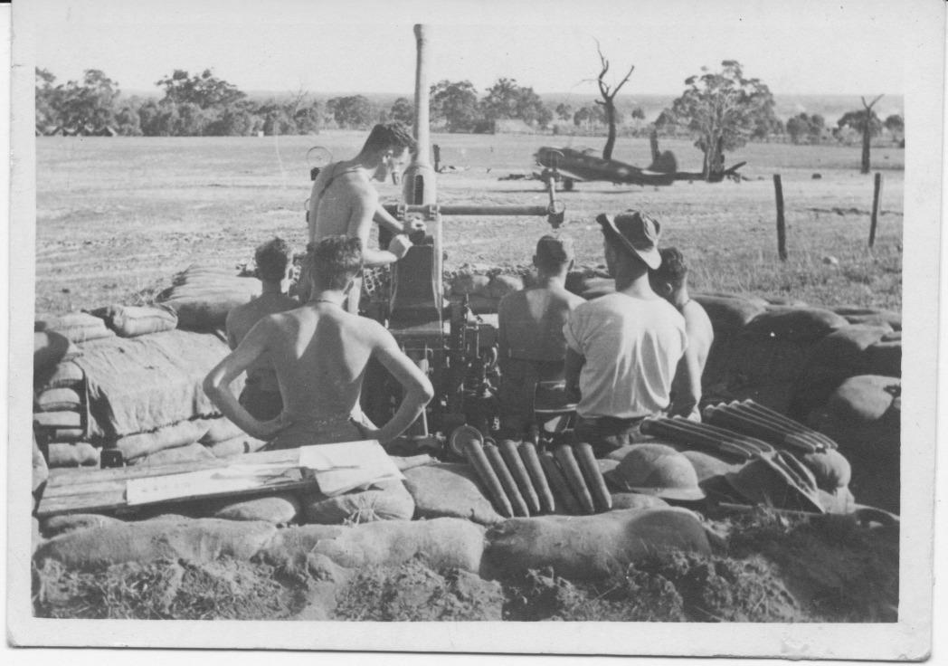
Sgt McDonald (7 Bty) Gun Crew Pearce WA 1942

Slide 87
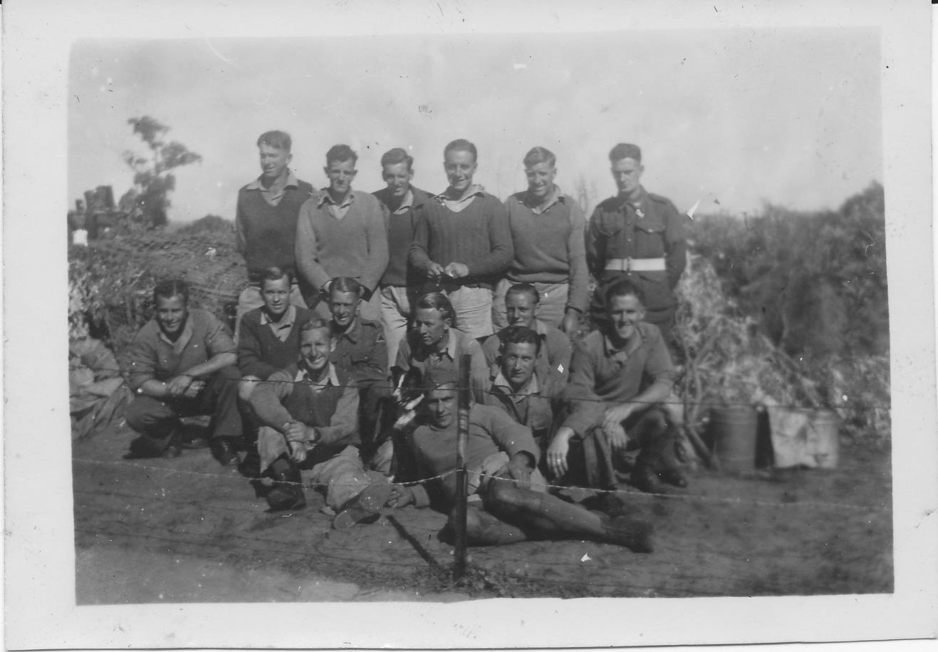
John Marshall (7 Bty) Gun Crew Pearce WA 1943

Slide 88
Harold Dickinson WA 1942

Slide 89
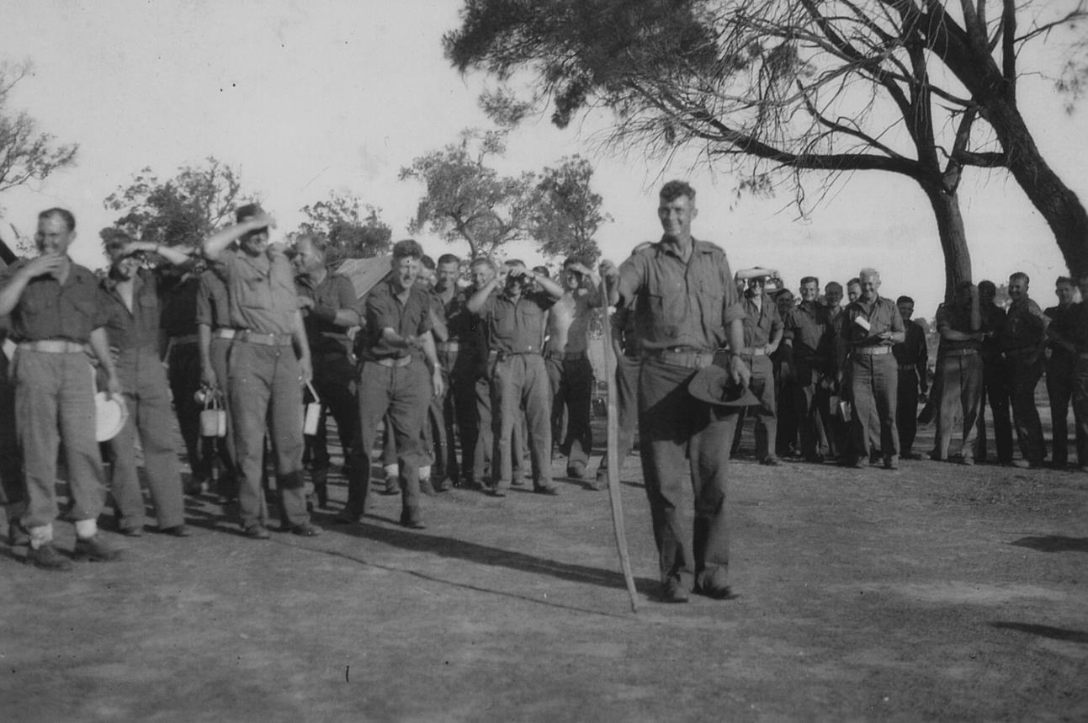
‘Snakes’ Clarke
Also known as ‘Carpet’ Clarke. Showing the troops how to crack the head off a black snake. He used to wear his hat like a bowler and was regularly asked by officers to fold his hat correctly. His response was that he kept his pet in his hat and when the officer insisted that he fold his hat correctly , ‘Snakes’ would ask the officer to hold his pet while he folded his hat. ‘Snakes’ would remove a snake generating much laughter as the officer fled.

Slide 90
Going to Geraldton

Slide 91
Some of the men of RHQ Christmas day 1942 Berkshire Valley, WA.

Slide 92
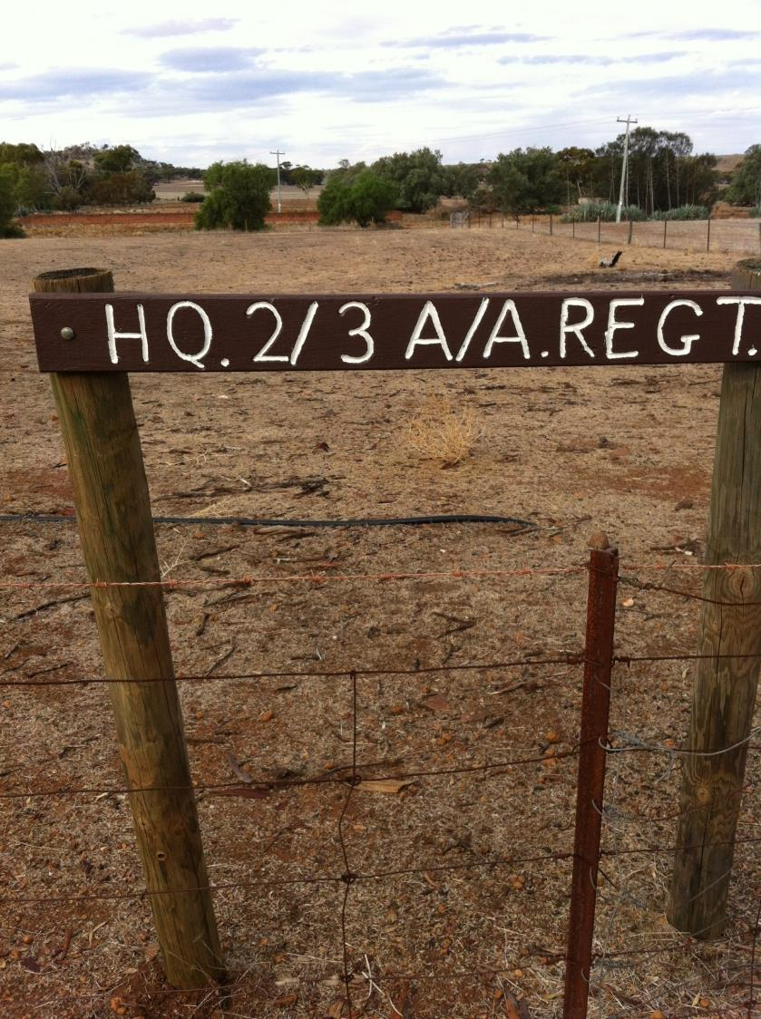
Sign showing the site of the 2/3 LAA Regiment Head Quarters camp in 1942 in the Berkshire Valley (WA).

Slide 93
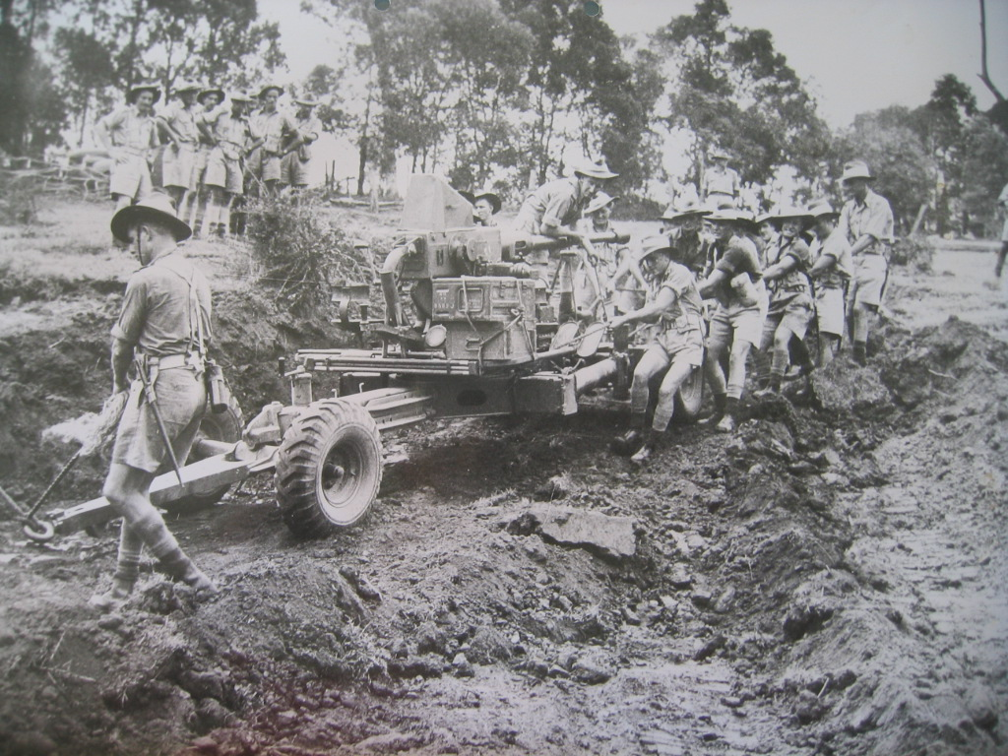
A bogged Bofors

Slide 94
Buna, New Guinea

Slide 95
Buna - New Guinea

Slide 96
Buna, New Guinea toilet facilities
The water table was about one foot below the land surface thus useless for digging a sewer.

Slide 97
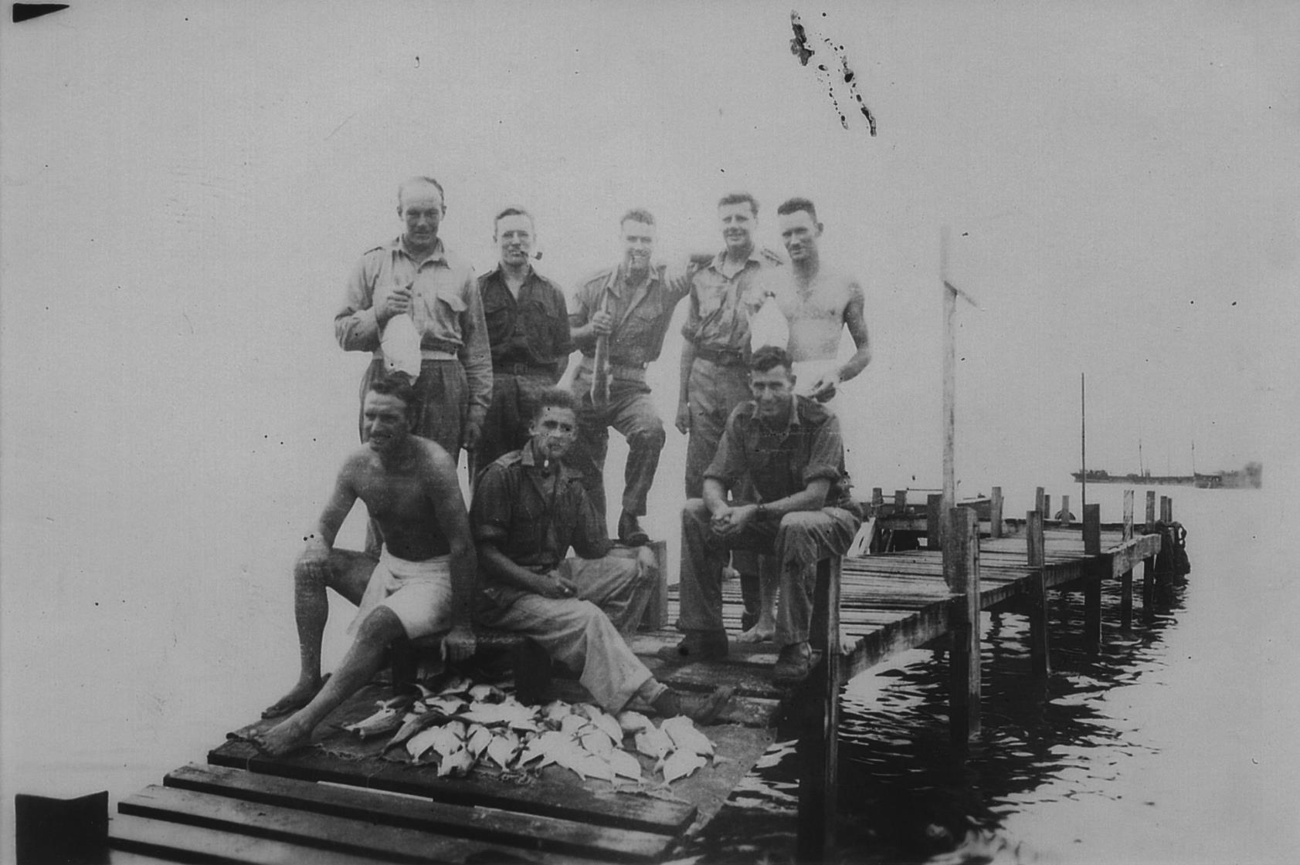
Fishing at Buna
Hand grenades did have their uses
Back from left: Col McNaughton, Roy Farr, Unidentified, S Young, G Young

Slide 98
Bofors crew returning to Australia on the Empire Pintail

Slide 99
7th Battery POWs Rol Tonkin’s Stalag office

Slide 100
Rol Tonkin and fellow POWs Stalag XIIIC

Slide 101
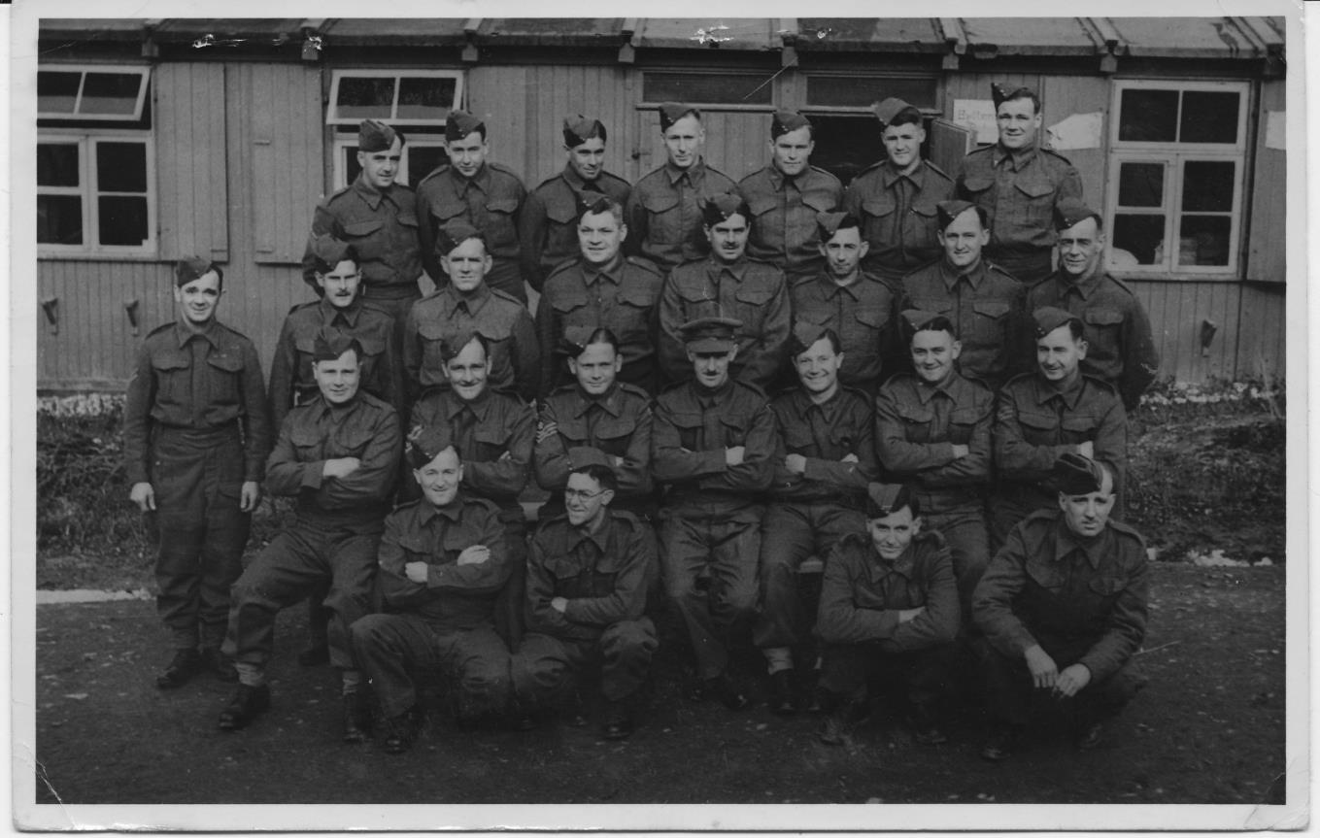
Australian POWs Stalag XIIIC March 1942
Rear from left: Sgt E Harry, Pte F Grant, S Dwight, L Williams, G Parker, F Leslie T St Leon
Standing: Cpl F Ritchie, Pte R Beale, Pte J Pearson, J Barrow, Cpl M Don, Sgt W Skene
Seated: Sgt R Dimall, Sgt Rol Tonkin, CQMS R Hamilton, RSM Brown, Sgt Karl Koska, Sgt Elliott, Sgt S Malcolm
Front: Pte J Devine, E Wright, R Tamblyn, G Ainsley

Slide 102
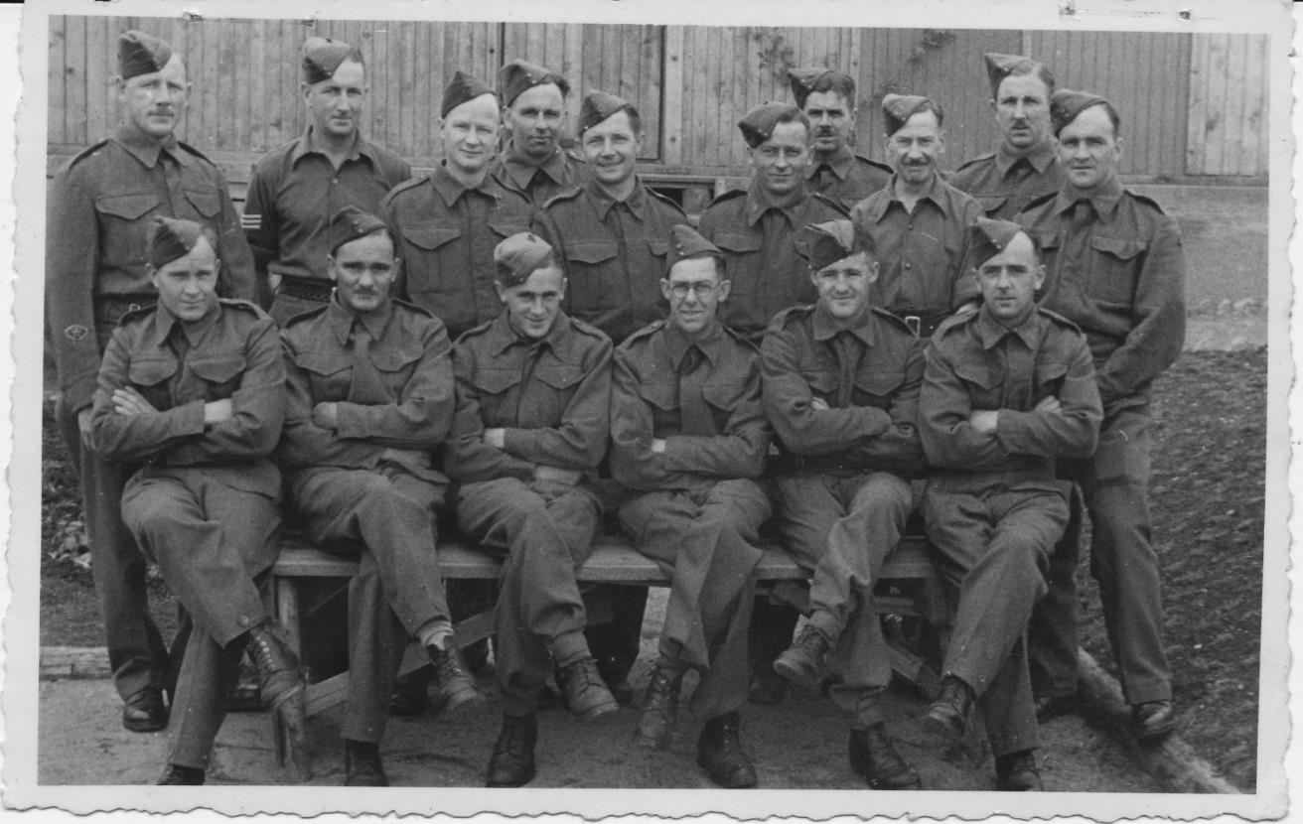
Victorian POWs Stalag XIIIC August 1943 Hammelburg, Germany
The Victorian contingent in the Lager were:
Rear from left: Duncan McLennan, Marty Wilson, Law Rolling, Charles Rutter, Karl Koska, Ron Phillips, Jack Barrow, Mac McDowell, Murray Storrer, Rol Tonkin
Front: Allan Selwood, Bill Westover, Bob Richardson, Ern Wright, Frank Leslie, Ted Harry

Slide 103
Law Rolling, Rol Tonkin and Carl Koska

Slide 104
POW group in Stalag XIIIC February 1944
Rear: Curly Chambers, Rol Tonkin, Don Rankin, Keith Dillon
Front: Lew Squires, Roy Hamilton, Bert Galloway

Slide 105
Promenading in Germany

Slide 106
An entry from Jack Curry’s (POW) diary

Slide 107
Letter home from Jack Curry

Slide 108
Letter home from Jack Curry after release

Slide 109
8th Battery
Libya
Tobruk
Derna
Benghazi
Palestine
Western Australia
New Guinea

Slide 110
8th Battery
At the end of 1940 the Australian 6th Division, as part of the 30,000 strong Western Desert Force, marched against the 250,000 strong Italian forces in Egypt and Libya. Despite some fierce resistance, the Allied Force captured Bardia, Tobruk, Benghazi and advanced to El Agheila. As the 6th Division was moved to Greece, the not so experienced 9th Division took over the captured areas.
The 8th Light Anti-aircraft Battery arrived at Tobruk in a small Polish tramp steamer, without guns or equipment. Tobruk was a rich prize with its good harbour and immense supplies of ammunition and stores abandoned by the Italians. The 8th Battery gunners were equipped with captured 20mm Breda light anti-aircraft guns. They spread out along the coast to Derna, Barce and Benghazi to assume the anti-aircraft defence of harbours and some aerodromes. They engaged some enemy aircraft, shooting down their first enemy plane at Benghazi.
At the end of March I94I, General Rommel, commander of the new German Africa Korps which had arrived in Tripoli, advanced eastwards.

Slide 111
So began the "Benghazi Handicap", being a withdrawal of allied forces to Tobruk and to Egypt. Thousands of men, trucks and guns streamed back along the coastal road. The Africa Korps headed south and east through the desert to outflank the retreating forces.
Thirty members of 8th Battery were captured. The remainder of the Battery reached Tobruk on 7"'April.
Apart from Navy and Air Force personnel, about 24,000 allied fighting troops were cut off and besieged by the 11th April. Surplus non-combatant people and enemy prisoners-of-war were evacuated by sea over the next couple of months. For the next five and a half months, the besieged troops who became known as the "Rats of Tobruk," lived through heat, sandstorms, extreme shortage of water, monotonous rations, severe bombing raids and heavy shelling from artillery; but never hesitated in their task of spirited defence and active retaliation.

Slide 112
During the Siege, the 8th Battery was credited with shooting down 23 enemy aircraft, 14 more were probably destroyed, 60 were badly damaged, and 100 others were hit.
In September 1941 , the gunners were evacuated from Tobruk by British destroyers which took them back to Alexandria. Although the men's health had been deteriorating, casualties had been light. Apart from the 30 men captured in the Retreat, 5 gunners had been killed and 16 were wounded.
Leaving Egypt, the Battery moved by train to Palestine where they rejoined the Regiment.
After six months in Palestine having leave, recuperation on good food, and training on Bofors guns, the Regiment returned to Australia. Home leave was granted, then the Battery travelled to Western Australia by train, as incursions by the Japanese along the west coast were anticipated.
The Battery, now equipped with good Bofors guns, was sited at the U.S. Navy's Catalina flying boat base at Crawley Bay, Perth, at airfields at Pearce, Geraldton, Onslow and at the submarine base at Exmouth Gulf.

Slide 113
The happy sojourn in the West (when several of the gunners married West Australian girls), came to an end when the Battery was relieved by 116th Light Anti-aircraft Regiment and went to a bush camp at Helidon, Queensland, to train as an airborne battery.
As the proposed airborne project faded out, the Battery then went on by sea to Buna, in New Guinea. Gun sites were taken over at the coast and near heavy A.A. guns and airstrips.
In the changed conditions from the Middle East and Western Australia, the Battery adapted to the jungle surroundings, the high kunai grass, mosquitoes and swamps.
With the United States' powerful air force rapidly gaining air supremacy in the area, after six months the Battery returned to Queensland, where it was sadly disbanded. Most of the men were transferred to other anti-aircraft units.

Slide 114
Ronald Berry
(VX 51751)
8 Battery
(left)

Slide 115
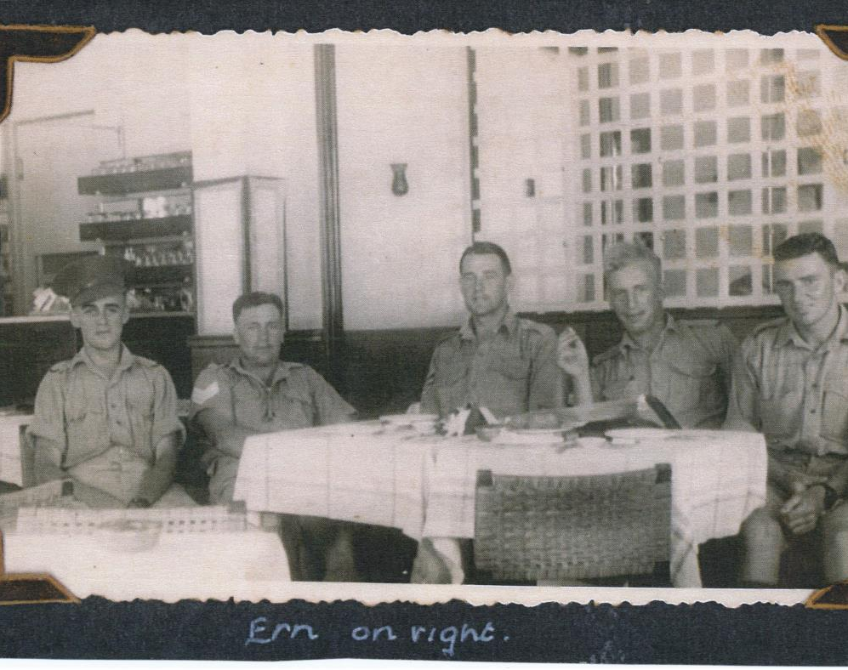
Ern Cope (right) and mates
Cairo 1941

Slide 117
8th Battery captured gun – Mac McGilvray

Slide 118
8th Battery Breda gun – John Campbell

Slide 119
8th Battery Breda gun crew

Slide 120
8th Battery - Cooks-Howat, Reid and mate

Slide 121
Bdr JL Courtney

Slide 122
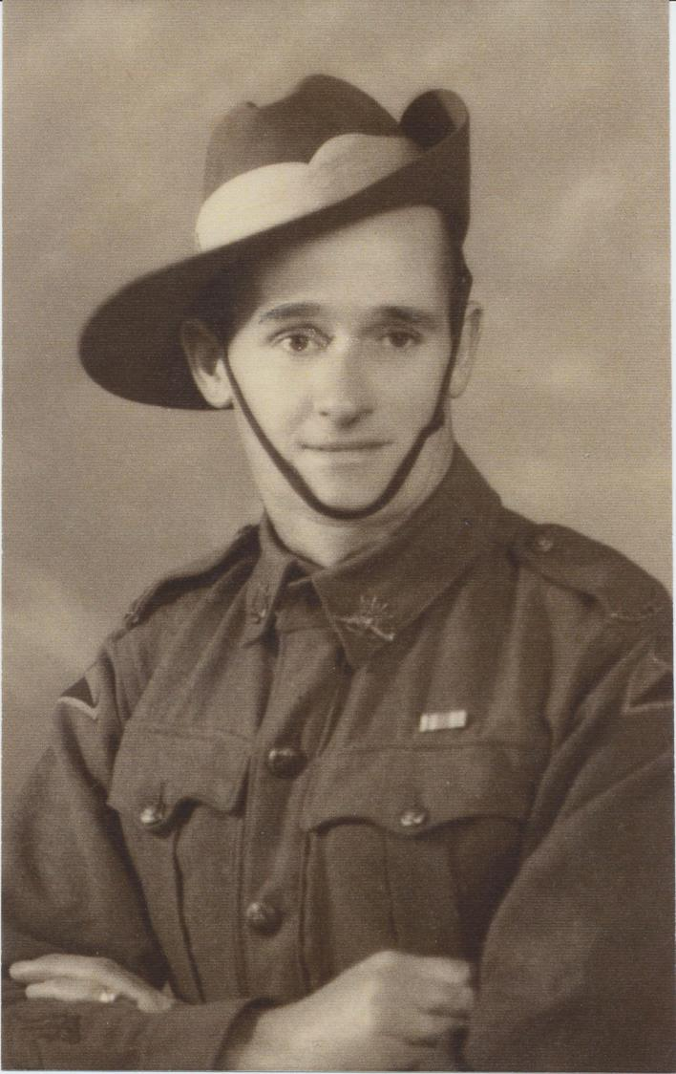
Vern Maxwell (8 Bty) August 1940

Slide 125
Derna

Slide 126
Bryant

Slide 127
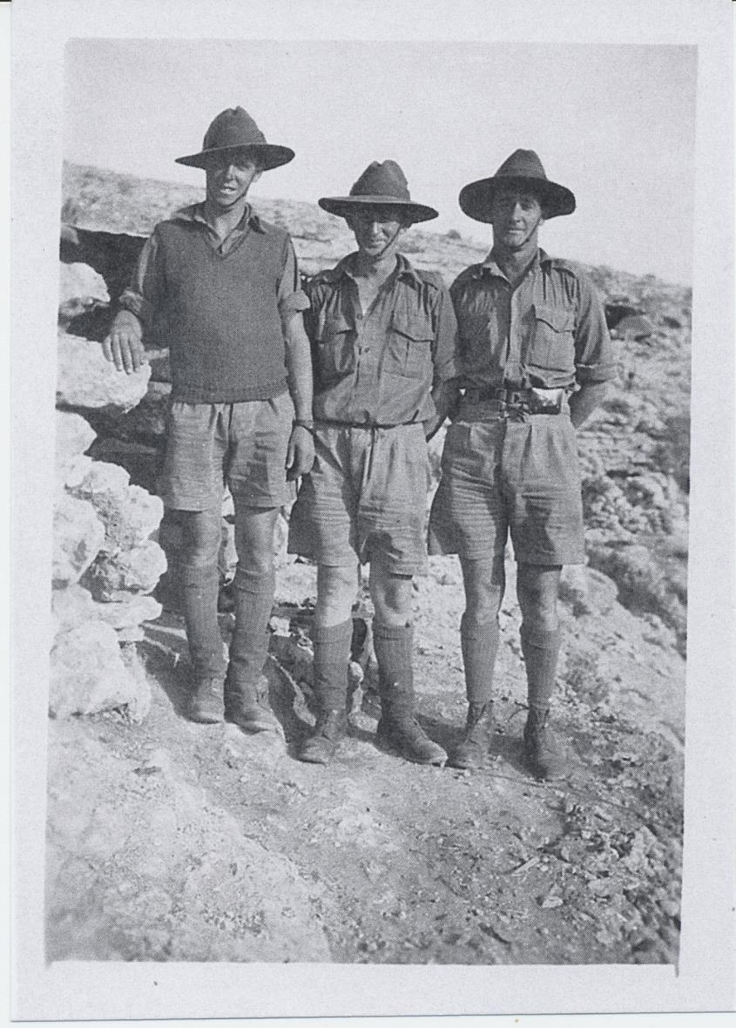
Bill Schack, Cec Palmer, Vern Maxwell February 1941

Slide 128
Gunner Greenwood 8th Battery

Slide 129
Benghazi

Slide 130
Benghazi retreat– mobile Breda

Slide 131
Tobruk – Stokes, Harry, Courtney

Slide 134
Plane spotting
Tobruk

Slide 135
Tobruk –
Bombardier Moyes
Relief Crew

Slide 136
Tobruk harbour

Slide 138
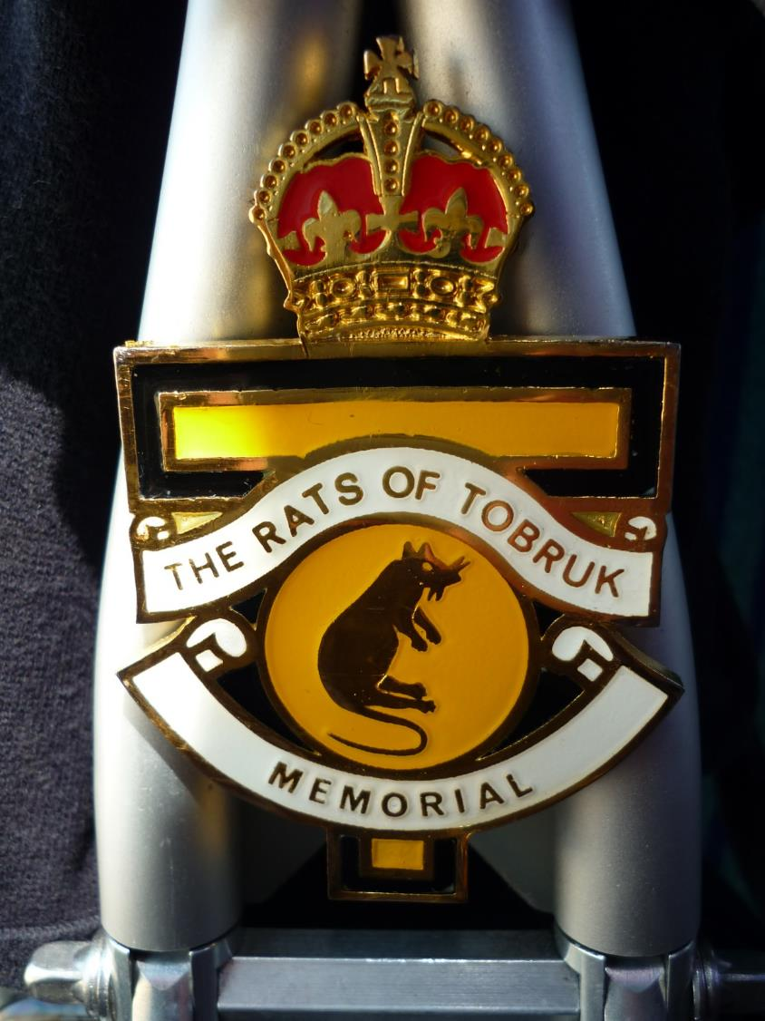
Rats of Tobruk Pipe and Drum Band Insignia
memorial Pipe and Drum

Slide 139
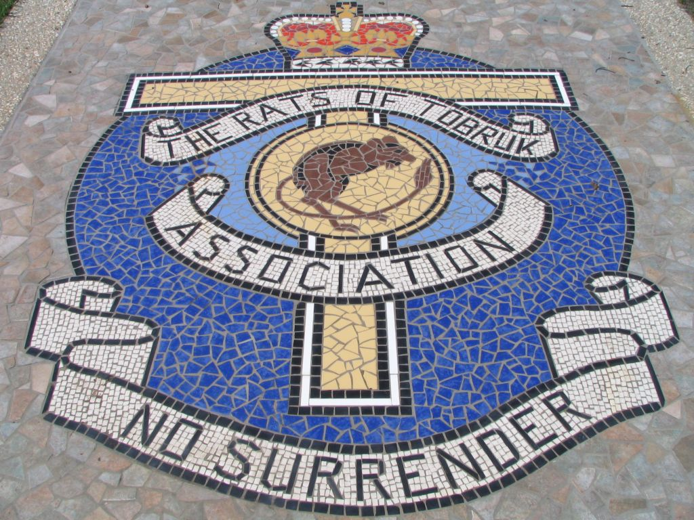
Rats of Tobruk mosaic Mackay, Queensland

Slide 140
Tribute to John Campbell (VX38276), 8 Battery; produced by the Descendants of the Rats of Tobruk Assoc. Inc.

Slide 141
Ron Bryant Palestine 1941

Slide 142
Ron Bryant, Sakkara, Egypt

Slide 143
John Campbell, Bob Campbell, John Bright

Slide 144
Ron Berry and Bob Campbell – 8th Battery

Slide 145
Jim Russell and mates

Slide 146
8 8 Battery
8 Battery
B Troop
Dunreath WA

Slide 147
Phil Roberts 8th Battery Later joined the British Forces and then became a Canon in the Church of England Ministry in England. First Vicar of St Michael and All Angels at Beaumaris Victoria.

Slide 148
Prigione di Guerra (Prison of War) 57 Grupignano, Italy
The Italian Prisoner of War Camp PG57 (Campo 57) was located in northern Italy. About 500 Australians captured in North Africa were held here as prisoners of war (POWs). The camp, situated in a wide plain surrounded by mountains, was a large compound containing wooden huts about 90 feet long and 30 feet wide. By October 1942 there were more than 1200 Australians and 1000 New Zealanders held in this camp.
Men from both 7th and 8th Battery spent time here.

Slide 149
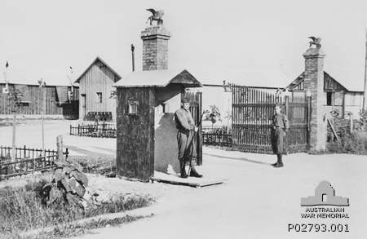
P.G. 57, Grupignano, Italy Housed both 7th and 8th Battery POWs
c. 1941
Courtesy Australian War Memorial www.awm.gov.au/collection

Slide 150
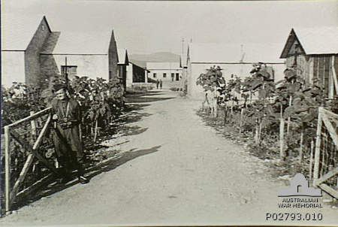
P.G. 57, Grupignano, Italy
Courtesy Australian War Memorial www.awm.gov.au/collection

Slide 151
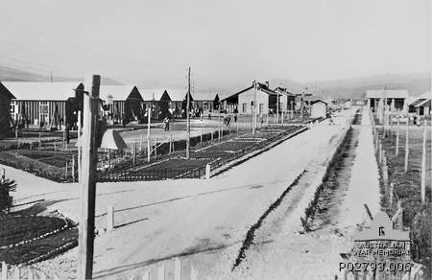
P.G. 57, Grupignano, Italy Housed both 7th and 8th Battery POWs
Courtesy Australian War Memorial www.awm.gov.au/collection

Slide 152
Bluey and Curley cartoon 29 November 1941

Slide 153
Bluey and Curley cartoon 14 March 1942

Slide 154
Col McNaughton, G. Young, Roy Farr, Ron Horner, Sgt. G. Davies and W. Weston
Buna, New Guinea
Col McNaughton, G Young, Roy Farr, Ron Horner, Sgt G Davies and M Weston
Buna New Guinea

Slide 155
Includes Col McNaughton, Roy Farr, S. Young, G. Young
Fishing in Buna, New Guinea

Slide 156
9 Battery
Western Desert
Beirut
Suez Canal Zone
Townsville
Milne Bay, Port Moresby, Lae
Borneo

Slide 157
9th Battery
The Battery moved from Khassa with 7th Battery to Amiriya in Egypt. A planned
voyage to Greece was cancelled as the Allied Forces there were in retreat from the
fateful campaign. On 23rd April, 1941, 9th Battery and Regimental Headquarters
moved into the Western Desert of Egypt.
The gunners provided anti-aircraft defence at several Royal Air Force stations. In
June they joined the British 7th Armoured Division in an advance towards Tobruk,
with the code name "Battle Axe", to push General Rommel's forces back, and to
join forces with the besieged garrison at Tobruk. The gunners had many
engagements with aircraft, shooting down several planes. One gun was lost and
one gunner was killed. The British losses to the superior German troops were
severe. "Battle Axe" was discontinued.
9th Battery was relieved and travelled to Cairo, then to Beirut, in Syria. The guns
of a British regiment were taken over. On 29th September 1941, the Battery moved
down to the Canal Zone to protect the Suez Canal against mine-laying and other
aircraft.

Slide 158
In January and February 1942, the Battery returned to Australia when some of the troops had home leave before proceeding with their equipment to Garbutt Airfield near Townsville.
In June, the men of the Battery loaded their guns, trucks and equipment onto a Dutch vessel, the Karsik. Most of the men embarked on the Macdhui (which was later destroyed by Japanese bombers) and all sailed to Port Moresby in New Guinea. B Troop remained at the airfield there, experiencing numerous air raids by the Japanese.
The remaining A and C Troops went on to land at Milne Bay. Here, the troops carried out many tasks including unloading ships, road making, and transporting of steel matting for the airstrip, as well as air defence.
From 25th August, the Battle for Milne Bay took place over several weeks, with Japanese naval bombardments, enemy infantry landings and aerial bombing, all of which were vigorously repulsed by the Australian infantry, artillery and airmen.

Slide 159
This was the first defeat of the Japanese invaders on land, to the extent that they were eventually evacuated from the area. Two men of 9th Battery died by accident.
The gunners suffered badly from malaria, causing manning problems. The Japanese continued to raid the area by air for many months.
Some 9th Battery gunners saw active service in Lae, Morotai (Indonesia) and North Borneo, taking part in landings and coping with enemy infiltrations in their areas. At the war's end, some took part in surrender operations. A few went to Japan with the Occupation Force; but most were glad to head for home as transport became available, after their five years or so in the Army, as did most of the other remaining members of the Regiment from their scattered positions.
In August 1945 peace was declared after Japan surrendered, however it wasn’t until 19th December when finally the troops, guns and equipment of the 9th Battery North East Borneo Force arrived back in Australia.

Slide 160
S/Sgt GL Bodycomb, Roberts, KA Read, Sgt AH Gay

Slide 161
Tel-Aviv leave
L to R: Cec Rae
Peter Allender
Ian Evans
9th Battery, early 1941, before going to Egypt.

Slide 162
9th Battery Tent group Khassa
Cec Rae Gerry Sampson Wal Webb Bill Astbury Max Bird

Slide 163
Western Desert – evening meal

Slide 164
Western Desert –food supply depot
Brin Boothby
Max Bird
Cec Rae

Slide 165
Western Desert – gun crew
Back row: ? Hec Bird, Wal Wright, Wal Webb, Brin Boothby, ? Jones, Bill Astbury
Middle: Fred Crees, ? Max Canning, ?, ?, Jim Paton
Front: ?, Max Bird, Cec Rae

Slide 166
Western Desert
Hec Bird, Cec Rae
Nipper Kean, Jack Gray, Bruce Paton, English RAF, Wal Webb, ?
Jim Paton, Max Bird

Slide 167
Gun at Sidi Birani

Slide 168
Mediteranean Sea at Sidi Birani

Slide 169
Leave - poolside
Possibly Mena House Cairo, after coming out of the Western Desert. Jim Paton back left.

Slide 170
9th Battery, Suez Canal

Slide 171
Cairo 1941
- Jim Paton,
Cec Rae,
Peter Allender

Slide 172
Suez Canal

Slide 173
Jim Paton fishing in Suez canal- Egypt

Slide 174
Egypt 1941
Charlie Heddle Bill Crowley, A. Jones J. McPherson E. McNichol Don Heddle

Slide 175
On top of a pyramid
Reg Goldfinch
Alan (Bushy) Read
Doug Pulsford
Geoff Clucas

Slide 176
“Plane shot down in Middle East” (RG Dowling) German downed aircraft

Slide 177
MV Ettrickbank Said to Adelaide with 9th Battery gun on forward hold. 23 similar vessels and others brought the regiment back to Australia

Slide 178
Townsville to Port Moresby SS Karsik gun transport
The Karsik was a Dutch ship captured from the Germans. She brought 9th Battery guns and ammunition from Townsville to Port Moresby. The Karsik and the Macdhui (that had brought many of the personnel) were severely bombed by Japanese but escaped damage.

Slide 179
Townsville to Port Moresby MV Macdhui gun 9th Battery
The Macdhui was subsequently sunk by Japanese bombing and still lies in Port Moresby harbour.
Mick Preece
Jim Silva

Slide 180
Port Moresby – Kila Kila airport

Slide 181
First truck off SS Karsik Milne Bay Gili Gili Wharf June 1942

Slide 182
Milne Bay No. 2 Field

Slide 183
Milne Bay campsite Lau Lau Island

Slide 184
Cec Rae at Milne Bay with Thompson machine gun

Slide 185
Milne Bay Jim Paton
(The cane furniture was acquired from Ladava Mission)

Slide 186
Milne Bay Jim Parkes building the kitchen for the gun, near the Lyall wharf

Slide 187
Milne Bay Doug Sinclair
The haul was possibly assisted by a hand grenade or a stick of gelignite.

Slide 188
Milne Bay Huck Finlay
“Where are those Jap planes?”

Slide 189
Milne Bay Gun near wharf

Slide 190
Milne Bay
The Anshun was sunk at Gili Gili Wharf by Japanese naval fire
Lau Lau Island just off coast where some of 9th were stationed

Slide 191
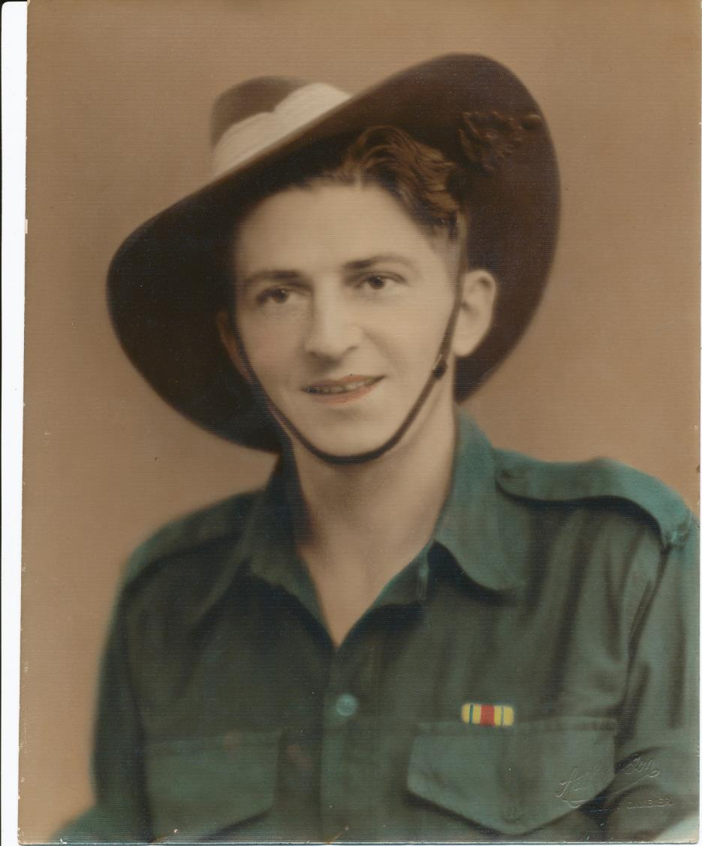
Ray Everlyn (9 Bty) in Jungle Greens 1943

Slide 192
Scott Quinn,
Charles Heddle,
Ted Lewis

Slide 193
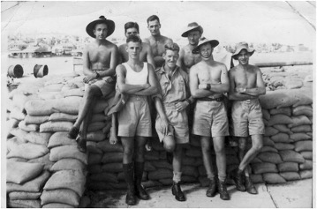
RG Dowling at back on left

Slide 194
Lae wharf
2/3rd Composite AA Regiment travelled in Landing Ship Tanks (LSTs) from Port Moresby

Slide 195
Lae – Plonk Perry and Eddy

Slide 196
Lae Max Bird

Slide 199
The Association
Formed on 9 July 1945
Garfield Margetts was appointed President and Gerry Haines Secretary of the Association
First function held 2 November 1945 at Prahran Drill Hall, wives and girlfriends invited
AIMS:
Preservation of the memory of fallen comrades
Retention of friendships
Arrange social occasions
Provide practical assistance to ex-regimental men in distress
On Target

Slide 200
Regiment Association Coronation publication1953

Slide 201
ANZAC DAY MARCH 1946

Slide 202
ANZAC DAY MARCH 1946

Slide 203
ANZAC DAY MARCH 1966

Slide 204
ANZAC DAY MARCH 1972

Slide 205
ANZAC DAY MARCH 1970’s

Slide 206
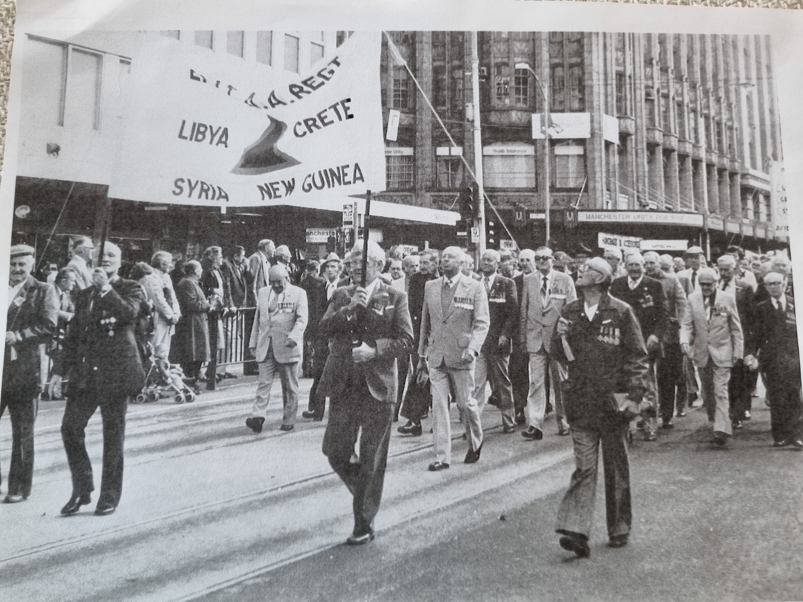

Slide 207
ANZAC DAY MARCH 1985

Slide 208
ANZAC DAY MARCH 1991

Slide 209
ANZAC DAY MARCH 1992

Slide 210
ANZAC DAY MARCH 1995
John Cec Jack Les
Hepworth Rae Crittenden Harris Mal Webster

Slide 211
ANZAC DAY MARCH 2003
John Campbell Ron Bryant Les Harris Ian Rutter Frank Hands

Slide 212
ANZAC DAY MARCH 2003

Slide 213
ANZAC DAY MARCH 2005
Dave Thomson

Slide 214
ANZAC DAY MARCH

Slide 215
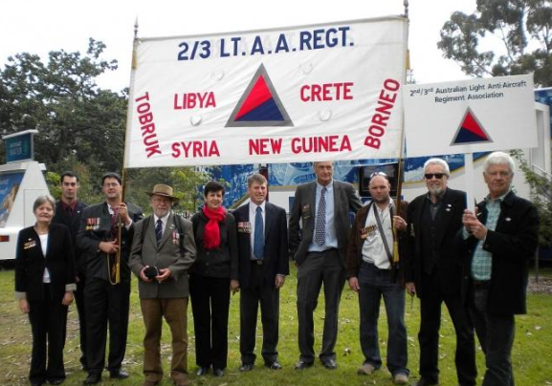
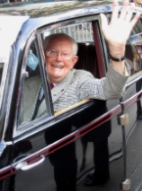
ANZAC DAY
MARCH 2011
After the march
Frank Hands

Slide 216
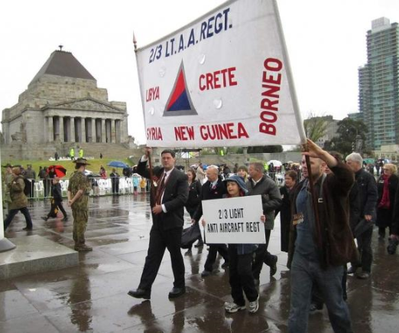
ANZAC DAY MARCH 2012

Slide 217
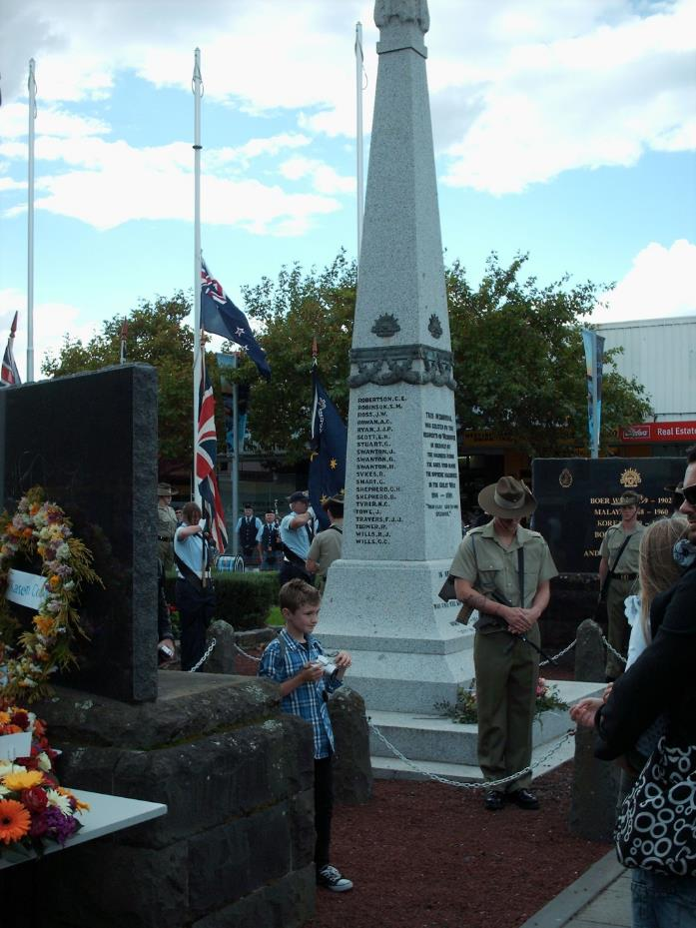
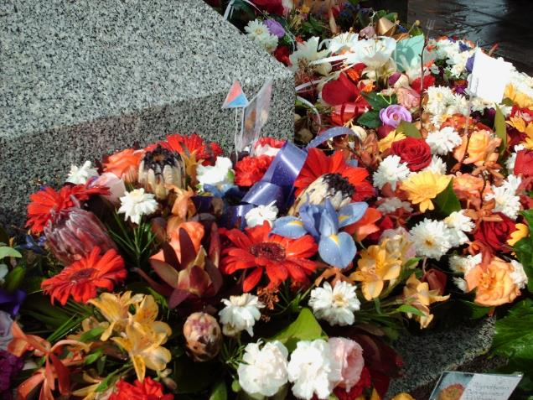
ANZAC Parade at Werribee
Matthew Heddle (Grandson of Charles Heddle[9th]) has represented the 2nd/3rd ALAA Regiment Association for the past ten years and laid a wreath on our behalf.

Slide 218
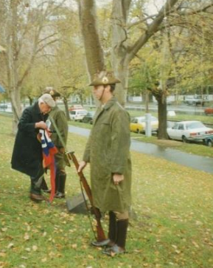
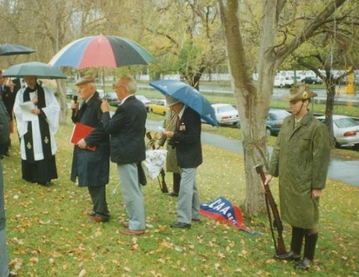
Shrine tree dedication and unveiling of the plaque
1997

Slide 219
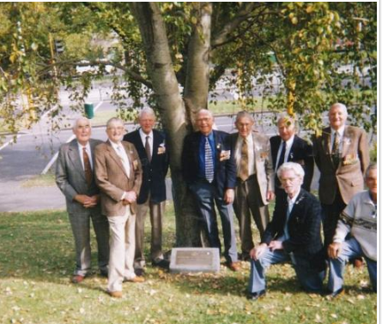
Shrine tree dedication and unveiling of the plaque
1997

Slide 220
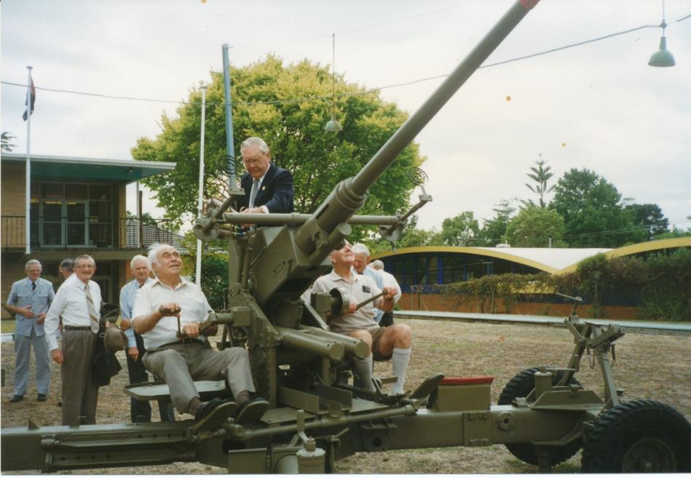
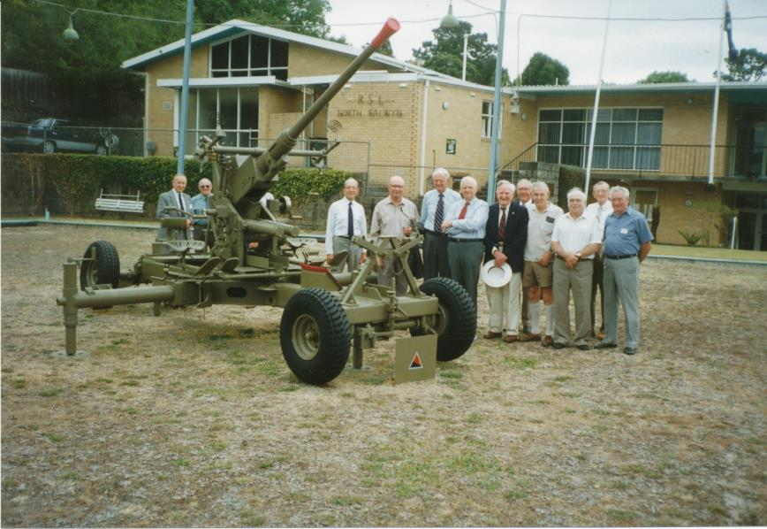
Balwyn RSL Bofors
Plaque affixed to Bofors at North Balwyn RSL – organised by Bruce Tulloch

Slide 221
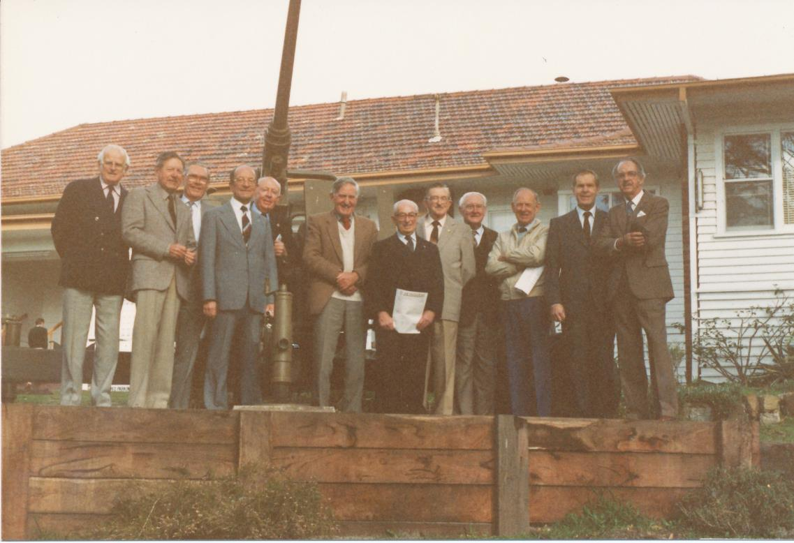
Beaumaris RSL Bofors
Presentation of copy of On Target to Club and affixing of a 2/3 colour patch on the Bofors gun at the front of the building.
John Hepworth, John Campbell, Jim Paton, Bruce Tulloch, Clive Rose, Les Harris, Cec Rae

Slide 222
From an unknown newspaper

Slide 223
Proposed by Clive Rose and Ron Bryant, the story of the Regiment was written by Cec Rae, Les Harris and Ron Bryant It was “self funded” Published in 1987 ISBN 0 73160049 5

Slide 224
After all that work! Unpacking ON TARGET
Cec Rae Ron Bryant Publisher Les Harris

Slide 225
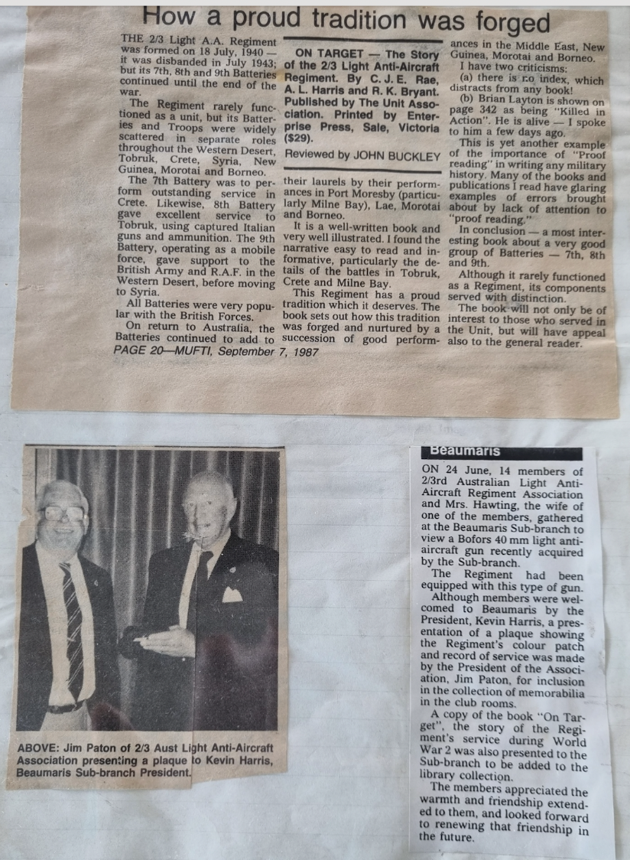

Slide 226
Plaque erected at Werribee Race Course in 2003. Organised by Graeme Heddle son of Charles Heddle – 9th Battery

Slide 227
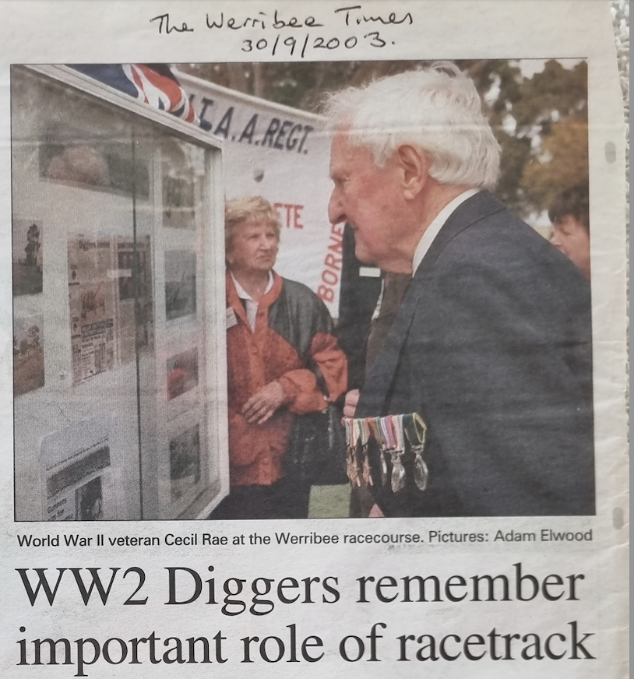

Slide 229
Possibly from Mufti 2003

Slide 230
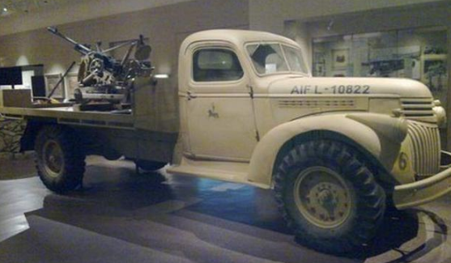
Australian War Memorial exhibition- Breda gun mounted on truck
8th Battery had not been issued with guns and on arrival at Tobruk had to make do with captured Italian 20mm Breda Lt A.A. guns.
They were mounted on trucks during the Benghazi retreat.

Slide 231
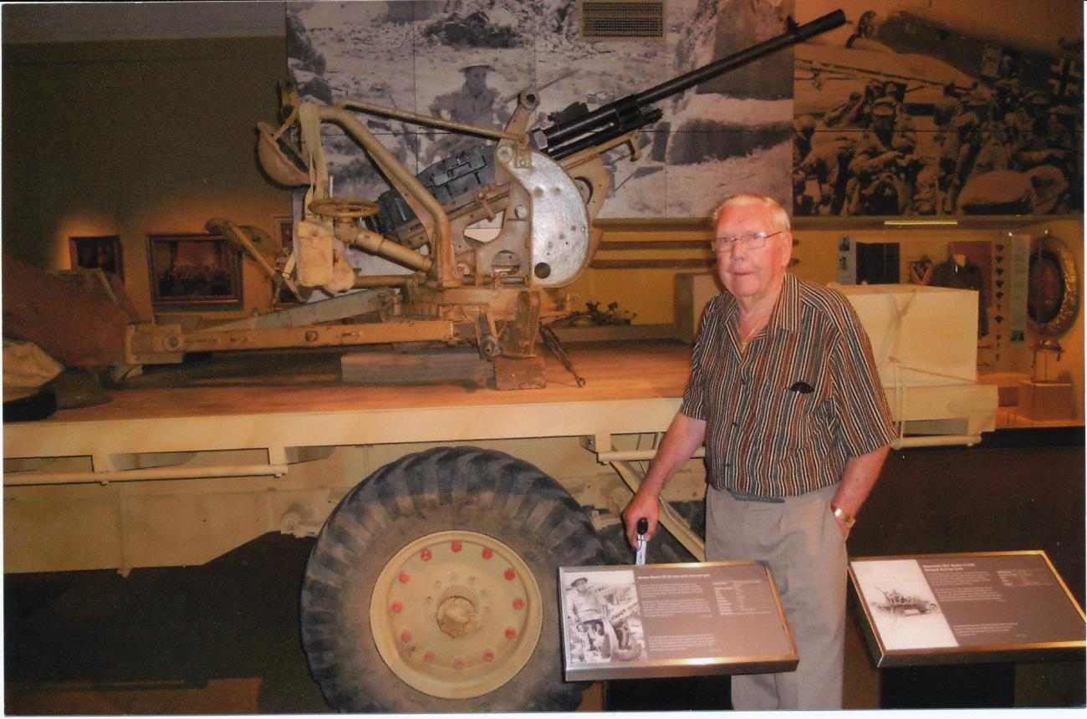
John Campbell (8 Bty) at Breda Memorial AWM 2012

Slide 232
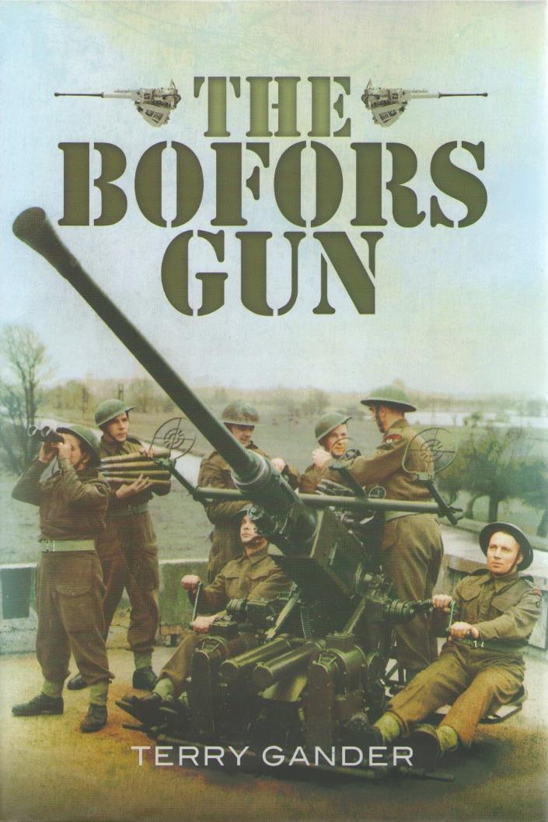
Published in 2013, this book describes the history of the Swedish 40mm Bofors gun. Its fundamentals have changed little through 80 + years of the gun’s existence.
See www.antiaircraft.org.au/about-us/bibliography

Slide 233
Air Defence Lunch 2012
Lt. Prue Connell, Lt. James Easton, John Campbell (8) and Lt. Sam Rynne.

Slide 234
Five serving Air Defence members and four 2nd/3rd veterans, along with President Lynton Rose, Secretary Colin Bragg and Association member Ian Rae, attended a luncheon held at the RACV City Club on 5 May 2012. This provided an opportunity for the serving members and veterans to exchange experiences and discuss changes in air defence weaponry.
Each of the veterans (John Campbell [8], John Marshall [8], Cec Rae [9] and Ian Rutter [7]) was presented with a highly polished 40mm Bofors shell as a memento of the occasion.

Slide 235
Capt. Michael Squire discusses the defence of Crete with Ian Rutter (7).

Slide 236
Lt. Prue Connell with John Marshall (7).

Slide 237
Cec Rae (9) and Lt. Jimmy Nguyen.

Slide 238
Air Defence Lunch 2012
Rear: Association President Lynton Rose, Lt. Sam Rynne, Lt. James Easton, Lt. Prue Connell, Capt. Mike Squire, Lt. Jimmy Nguyen, Ian Rae (Son of Cec Rae) and Association Secretary Colin Bragg. Seated: Cec Rae (9), Ian Rutter (7), John Marshall (7) and John Campbell (8).

Slide 239
2013 AGM and Reunion

Slide 240
2019
Anzac Day March
Melbourne
Members of the 2/3rd Australian Light Anti-Aircraft Regiment Association Inc.

Slide 241
John Campbell attending the 2021 ANZAC Day March at Mentone along with sons Peter and Ian and with the 2/3rd ALAA Regiment Association banner.

Slide 243
2022
Anzac Day March
Melbourne
Members of the 2/3rd Australian Light Anti-Aircraft Regiment Association Inc

Slide 244
2022 Anzac Day March Melbourne Members of the 2/3rd Australian Light Anti-Aircraft Regiment Association Inc

Slide 245
2022 Anzac Day March Melbourne 2/3rd ALAA Regiment banner approaching the Shrine of Remembrance As seen on TV! Photo courtesy the Prideaux family

Slide 246
Members visiting the Regiment’s memorial tree and plaque in the Shrine lawns.

Slide 247
This memorial Quercus acutissima (Japanese Chestnut Oak) replaced the original Simon Poplar that was removed some years ago.

Slide 248
Memorial plaque beneath the Japanese chestnut oak.

Slide 249
2023 Rats Of Tobruk Commemoration

Slide 250
2023 Rats Of Tobruk Commemoration

Slide 251
2023 Anzac Day March

